Slide 1
Trees
What is a Tree?
Tree terminology
Why trees?
General Trees and their implementation
N-ary Trees
N-ary Trees implementation
Implementing trees
Binary trees
Binary trees implementation
Application of Binary trees

Slide 2
What is a Tree?
A tree, is a finite set of nodes together with a finite set of directed edges that define parent-child relationships. Each directed edge connects a parent to its child. Example:
  Nodes={A,B,C,D,E,f,G,H}
  Edges={(A,B),(A,E),(B,F),(B,G),(B,H),
  (E,C),(E,D)}
A directed path from node m1 to node m_{k} is a list of nodes m₁, m₂, . . . , m_{k} such that each is the parent of the next node in the list. The length of such a path is k - 1.
Example: A, E, C is a directed path of length 2.
A
E
B
D
C
F
H
G

Slide 3
What is a Tree? (contd.)
A tree satisfies the following properties:
  It has one designated node, called the root, that has no parent.
  Every node, except the root, has exactly one parent.
  A node may have zero or more children.
  There is a unique directed path from the root to each node.
5
5
5
1
3
2
3
2
3
2
4
1
6
4
1
6
4
6
tree
Not a tree
Not a tree

Slide 4
Tree Terminology
Ordered tree: A tree in which the children of each node are linearly ordered (usually from left to right).
Ancestor of a node v: Any node, including v itself, on the path from the root to the node.
Proper ancestor of a node v: Any node, excluding v, on the path from the root to the node.
A
proper ancestors of E
Ancestors of G
B
C
D
E
F
G
An Ordered Tree

Slide 5
Tree Terminology (Contd.)
Descendant of a node v: Any node, including v itself, on any path from the node to a leaf node (i.e., a node with no children).
Proper descendant of a node v: Any node, excluding v, on any path from the node to a leaf node.
Subtree of a node v: A tree rooted at a child of v.
A
Proper descendants of node B
B
C
Descendants of a node C
D
E
F
G
A
B
C
D
E
F
G
subtrees of node A

Slide 6
Tree Terminology (Contd.)
A
A
parent of node D
B
C
grandfather of nodes I,J
D
E
G
F
child of node D
H
I
J
grandchildren of node C
subtrees of A
proper ancestors of node H
A
A
B
C
D
E
F
G
proper descendants of node C
H
I
J
Empty tree: A tree in which the root node key is null and all subtree references are null.

Slide 7
Tree Terminology (Contd.)
Degree: The number of non-empty subtrees of a node
  Each of node D and B
  has degree 1.
  Each of node A and E
  has degree 2.
  Node C has degree 3.
  Each of node F,G,H,I,J has degree 0.
Leaf: A node with degree 0.
Internal or interior node: a node with degree greater than 0.
Siblings: Nodes that have the same parent.
Size: The number of nodes in a tree.
An Ordered Tree with size of 10
Siblings of A
A
A
B
C
D
E
G
F
H
I
J
Siblings of E

Slide 8
Tree Terminology (Contd.)
Level (or depth) of a node v: The length of the path from the root to v
(i.e., the number of edges from the root to v).
Height of a node v: The length of the longest path from v to a leaf node (i.e., the number of edges on the longest path from v to a leaf node)
  The height of a tree is the height of its root mode.
  The height of a leaf node is 0.
  By definition the height of an empty tree is -1.
Level 0
Level 1
Level 2
Level 3
Level 4
A
A
The height of the tree is 4.
The height of node C is 3.
B
C
D
E
F
G
H
I
J
K

Slide 9
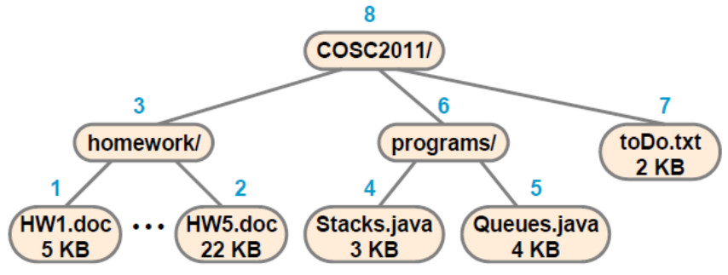

Why Trees?
Trees are very important data structures in computing.
They are suitable for:
  Hierarchical structure representation, e.g.,
    File directory.
    Organizational structure of an institution.
    Class inheritance tree in a single inheritance language

Slide 10
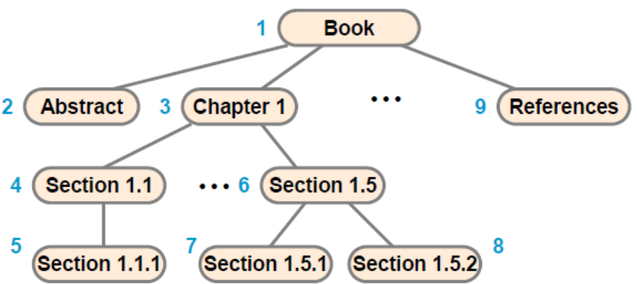
Why Trees? (Contd.)
    Textbook Organization
  Problem representation, e.g.,
    Expression trees.
    Decision trees.
    Game trees.
  Efficient algorithmic solutions, e.g.,
    Search trees.
    Efficient priority queues via heaps.

Slide 11
General Trees and their Implementation
In a general tree, there is no limit to the number of children that a node can have.
Representing a general tree by linked lists:
  Each node has a linked list of the subtrees of that node.
  Each element of the linked list is a subtree of the current node
public class GeneralTree extends AbstractContainer
implements Comparable{
protected Object key ;
protected int degree ;
protected MyLinkedList list ;
// . . .
}

Slide 12
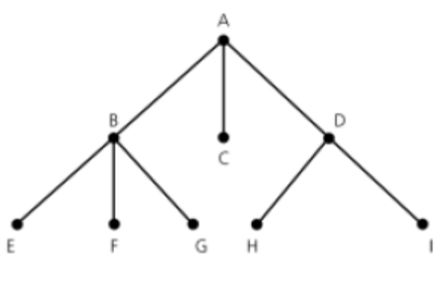
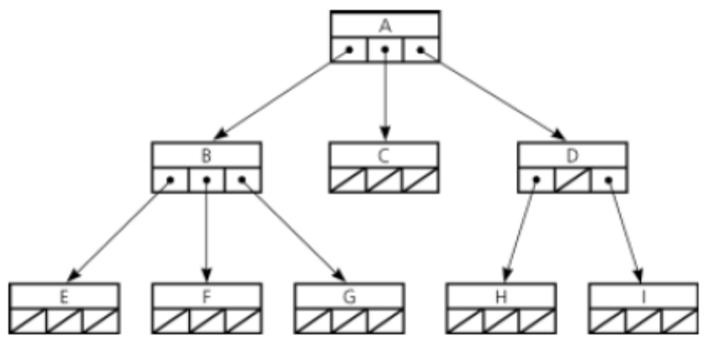
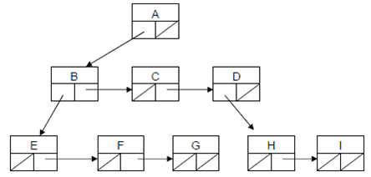
General Trees and their Implementation (Contd.)
representation1
representation2
Two representations of a general tree. The second representation uses
less memory; however it may require more node access time.

Slide 13
N-ary Trees
An N-ary tree is an ordered tree that is either:
  Empty, or
  It consists of a root node and at most N non-empty N-ary subtrees.
It follows that the degree of each node in an N-ary tree is at most N.
Example of N-ary trees:
5
B
2
7
D
D
F
2-ary (binary) tree
3-ary (tertiary)tree
9
5
C
G
B
J
E
A

Slide 14
N-ary Trees Implementation
public class NaryTree extends AbstractContainer
implements Comparable {
protected Object key ;
protected int degree ;
protected NaryTree[ ] subtree ;
// creates an empty tree
public NaryTree(int degree){
key = null ; this.degree = degree ;
subtree = null ;
}
public NaryTree(int degree, Object key){
this.key = key ;
this.degree = degree ;
subtree = new NaryTree[degree] ;
for(int i = 0; i < degree; i++)
subtree[i] = new NaryTree(degree);
}
// . . .
}

Slide 15
Binary Trees
A binary tree is an N-ary tree for which N = 2.
Thus, a binary tree is either:
  An empty tree, or
  A tree consisting of a root node and at most two non-empty binary subtrees.
Example:
5
2
7
9
5

Slide 16
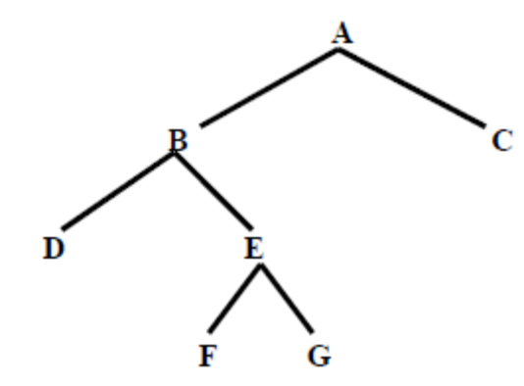
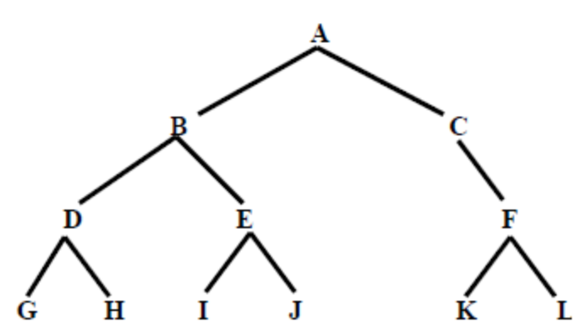
Binary Trees (Contd.)
A two-tree is either an empty binary tree or a binary tree in which each non-leaf node has two non-empty subtrees.
An example of a two-tree:
An example of a binary tree that is not a two-tree:

Slide 17

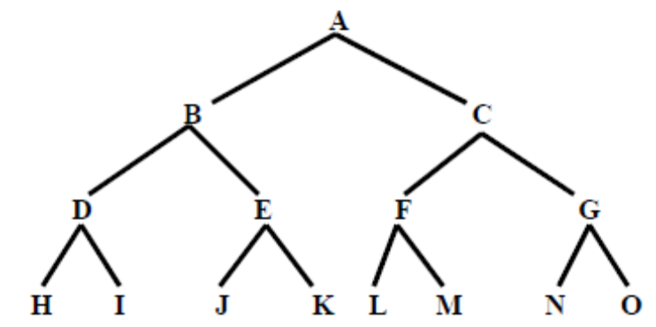
Binary Trees (Contd.)
A full binary tree is either an empty binary tree or a binary tree in which each level k, k > 0, has 2^{k} nodes.
  A full binary tree is a two-tree in which all the leaves have the same depth.
An example of a full binary tree:

Slide 18
Binary Trees (Contd.)
For a non-empty full binary tree with n nodes and height h:
2 ^{h} = (n + 1) / 2
→ h = log ₂ ((n + 1) / 2))
= log₂(n + 1) - 1
→ A full binary tree has height that is logarithmic in n, where n
is the number of nodes in the tree

Slide 19
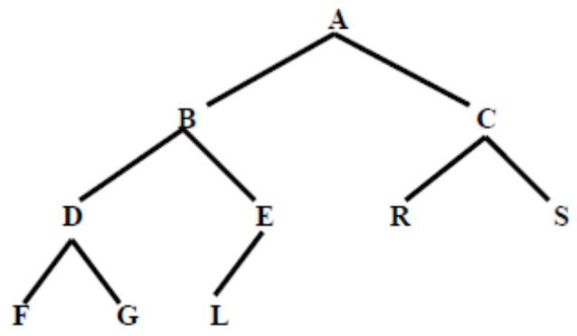
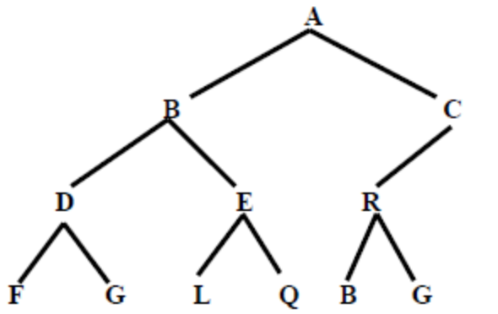
Binary Trees (Contd.)
A complete binary tree is either an empty binary tree or a binary tree in which:
  Each level k, k > 0, other than the last level contains the maximum number of nodes for that level, that is 2^{k}.
  The last level may or may not contain the maximum number of nodes.
  The nodes in the last level are filled from left to right.
Thus, every full binary tree is a complete binary tree, but the opposite is not true.
An example of a complete and a non-complete binary tree:
Complete
non-complete

Slide 20
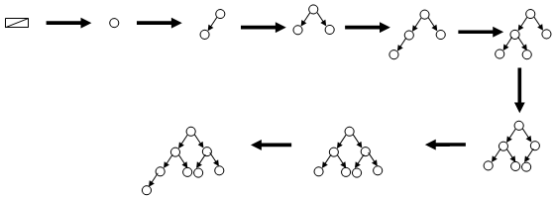
Binary Trees (Contd.)
Example showing the growth of a complete binary tree:
Note: The height of a complete binary tree with n nodes is h = ⌊log₂(n)⌋
Note: The literature contains contradicting definitions for full and complete
binary trees. In this course we will use the definitions in slide 17 and 18

Slide 21
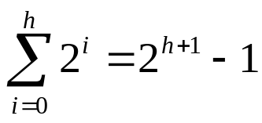
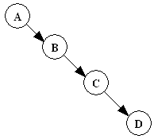
Binary Trees (Contd.)
For a binary tree of height h :
  Maximum number of nodes is h + 1 (for a linear tree)
  Minimum number of nodes is (for a full tree)
For a binary tree with n nodes:
  Maximum height is n – 1 (for a linear tree)
  Minimum height is log₂(n + 1) – 1 (for a full tree)
Example of a linear tree:

Slide 22
Binary Trees Implementation
public class BinaryTree
extends AbstractContainer implements Comparable{
protected Object key ;
protected BinaryTree left, right ;
public BinaryTree(Object key,
BinaryTree left,
BinaryTree right){
this.key = key ;
this.left = left ;
this.right = right ;
}
// creates empty binary tree
public BinaryTree( ) {
this(null, null, null) ;
}
// creates leaf node
public BinaryTree(Object key){
this(key, new BinaryTree( ),
new BinaryTree( ));
}
// . . .
}
left | key | right
Example: A binary tree representing a + (b - c) * d
+
a
*
-
d
b
c

Slide 23
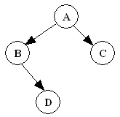
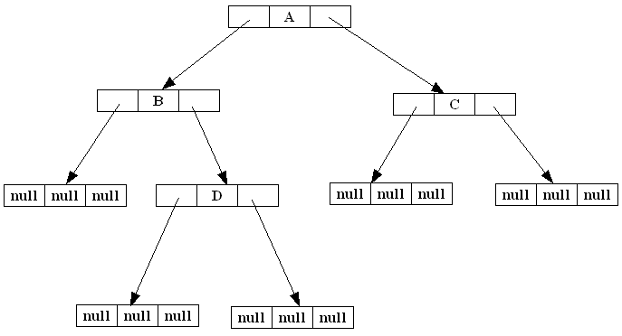
Binary Trees Implementation (Contd.)
In our implementation an empty tree is a tree in which key, left, and right are all null:
null | null | null
A tree such as:
is represented as:

Slide 24
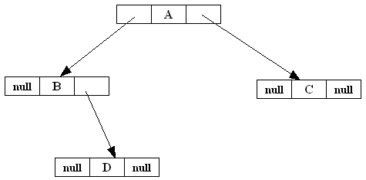
Binary Trees Implementation (Contd.)
In most of the literature, the tree:
is represented as:

Slide 25
Binary Trees Implementation (Contd.)
public boolean isEmpty( ){ return key == null ; }
public boolean isLeaf( ){
return ! isEmpty( ) && left.isEmpty( ) && right.isEmpty( ) ; }
public Object getKey( ){
if(isEmpty( )) throw new InvalidOperationException( ) ;
else return key ;
}
public int getHeight( ){
if(isEmpty( )) return -1 ;
else
return 1 + Math.max(left.getHeight( ), right.getHeight( )) ;
}
public void attachKey(Object obj){
if(! isEmpty( )) throw new InvalidOperationException( ) ;
else{
key = obj ;
left = new BinaryTree( ) ;
right = new BinaryTree( ) ;
}
}

Slide 26
Binary Trees Implementation (Contd.)
public Object detachKey( ){
if(! isLeaf( )) throw new InvalidOperationException( ) ;
else {
Object obj = key ;
key = null ;
left = null ;
right = null ;
return obj ;
}
}
public BinaryTree getLeft( ){
if(isEmpty( )) throw new InvalidOperationException( ) ;
else return left ;
}
public BinaryTree getRight( ){
if(isEmpty( )) throw new InvalidOperationException( ) ;
else return right ;
}

Slide 27
Applications of Binary Trees
Binary trees have many important uses. Three examples are:
1. Binary decision trees
    Internal nodes are conditions. Leaf nodes denote decisions.
2. Expression Trees
false
Condition1
True
decision1
Condition2
false
True
decision2
Condition3
false
True
decision3
decision4
+
a
*
-
d
b
c

Slide 28
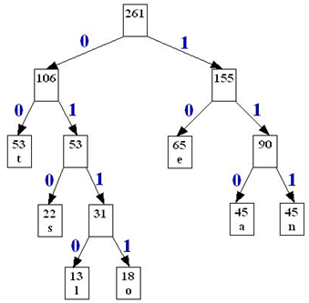
Applications of Binary Trees (Contd.)
  3. Huffman code trees
In a later lesson we will learn how to use such trees to perform data compression and decompression

